Slide 1
IP Subnetting – Zero to Hero IP Summarization
CyberQuince

Slide 2
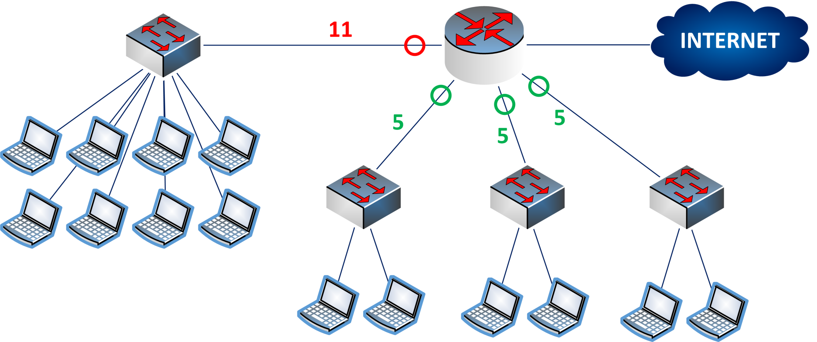
An Example

Slide 3
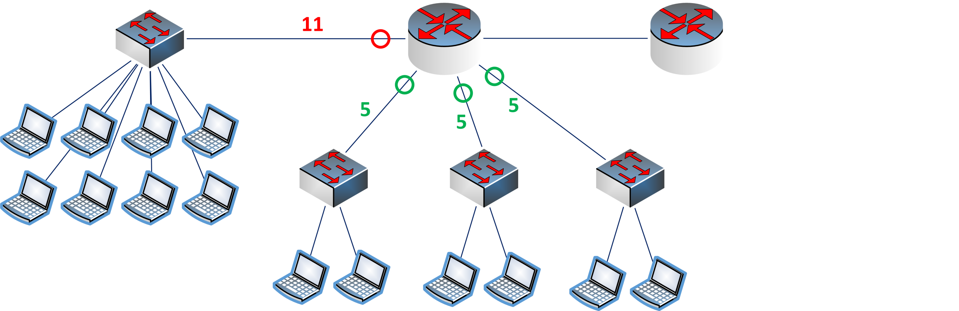
An Example

Slide 4
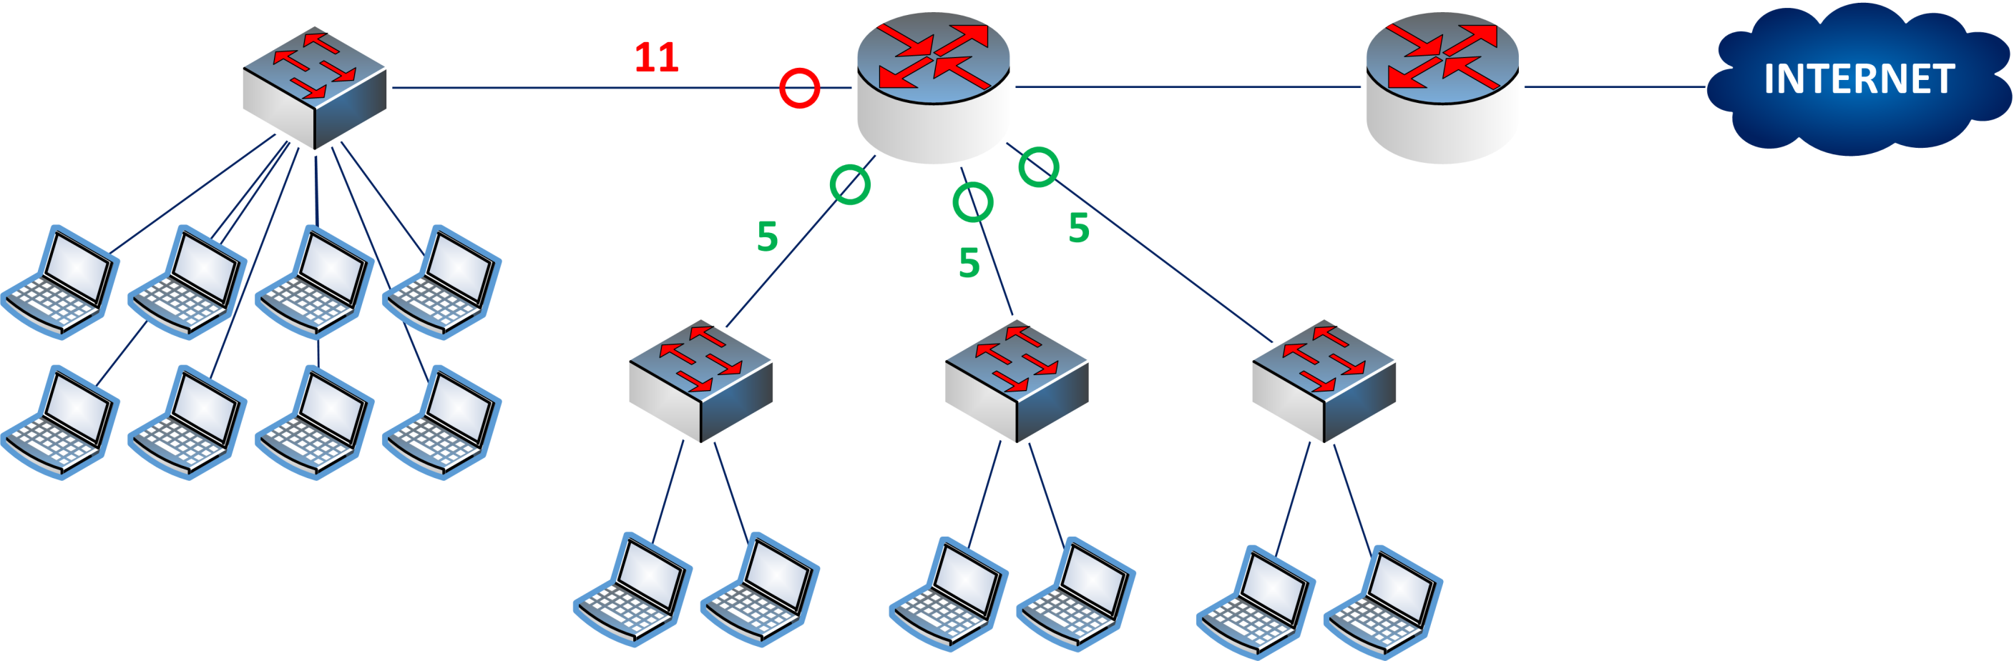
An Example

Slide 5
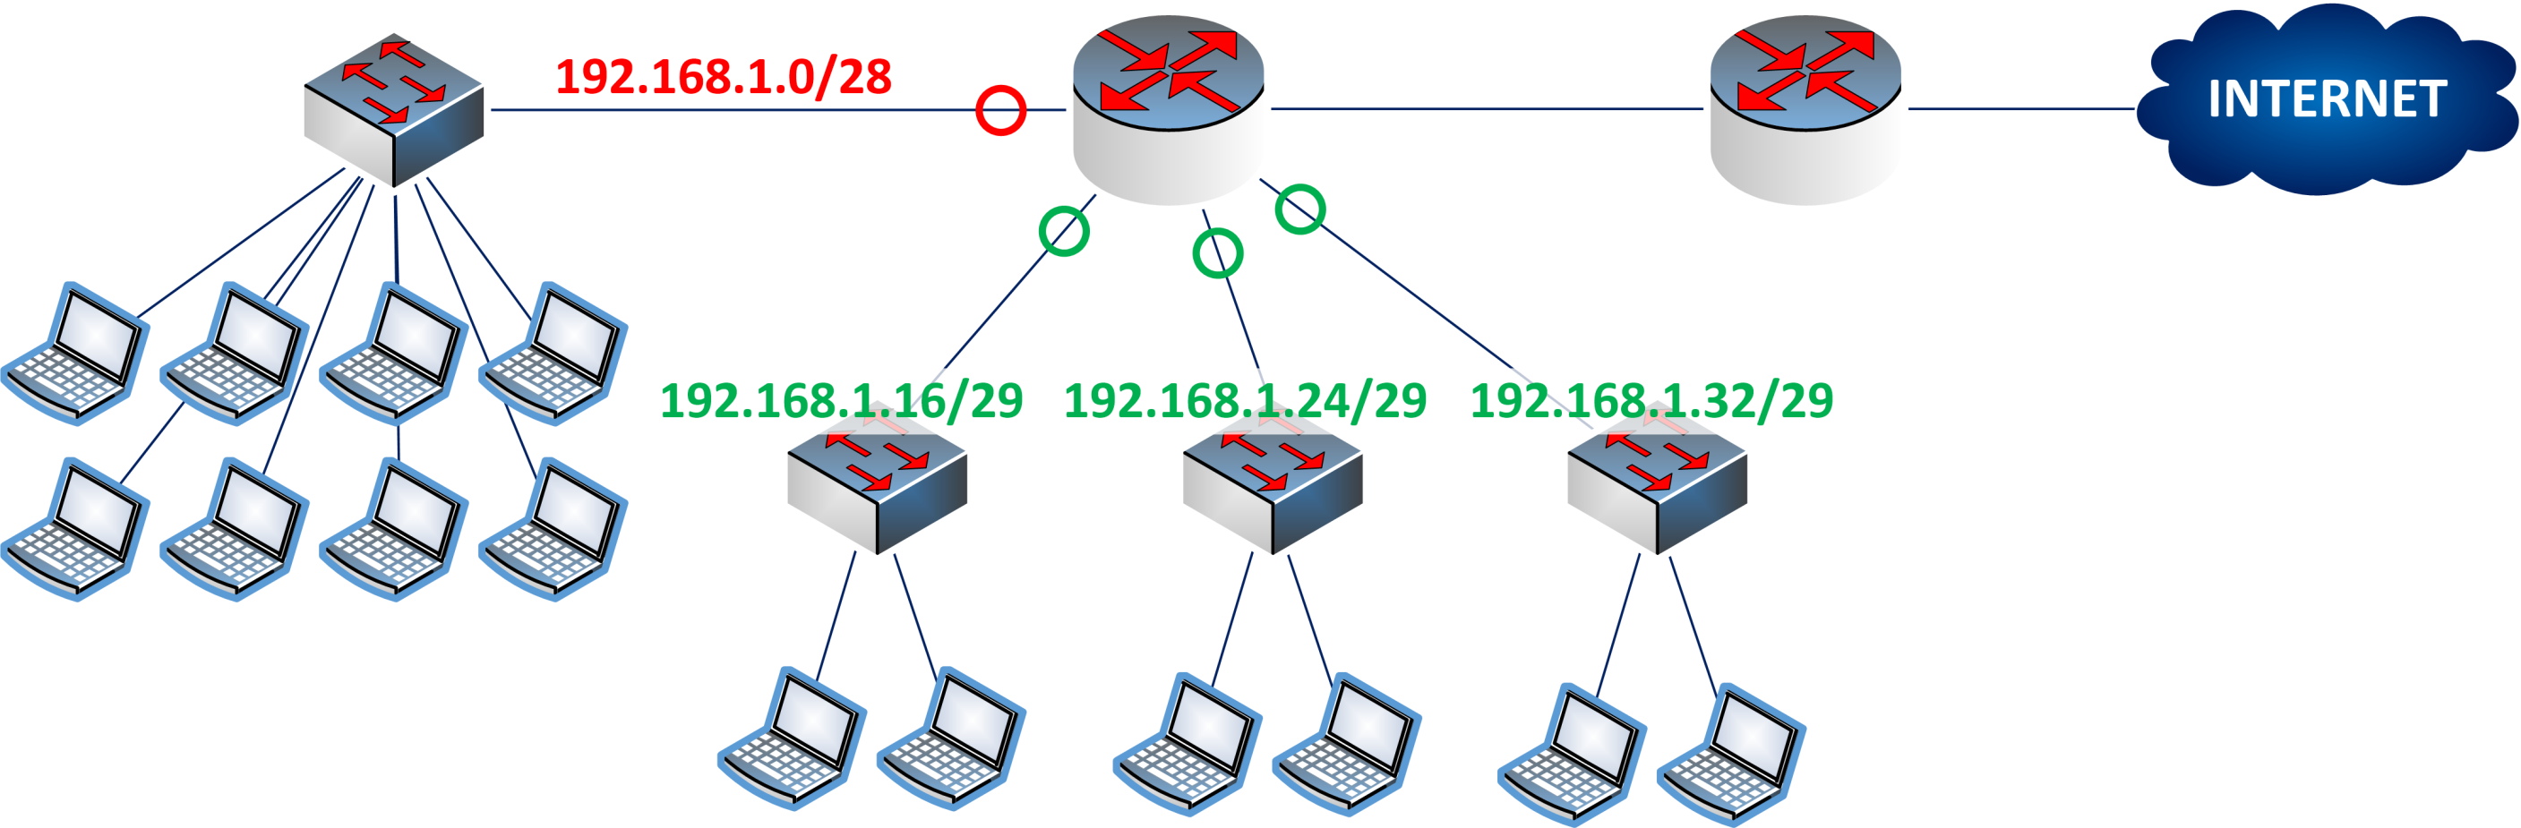
An Example

Slide 6
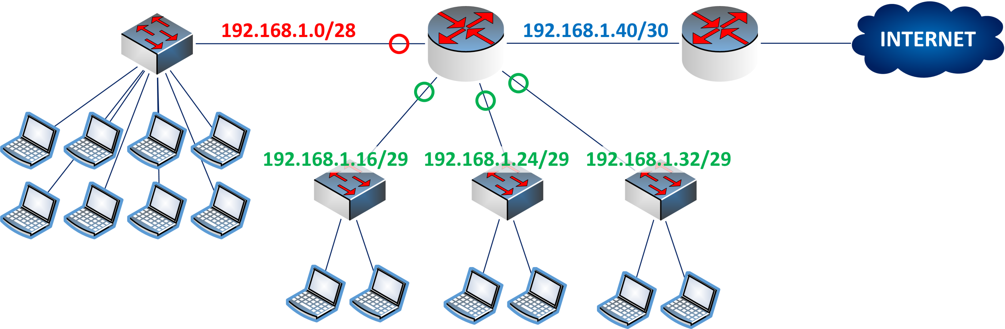
An Example

Slide 7
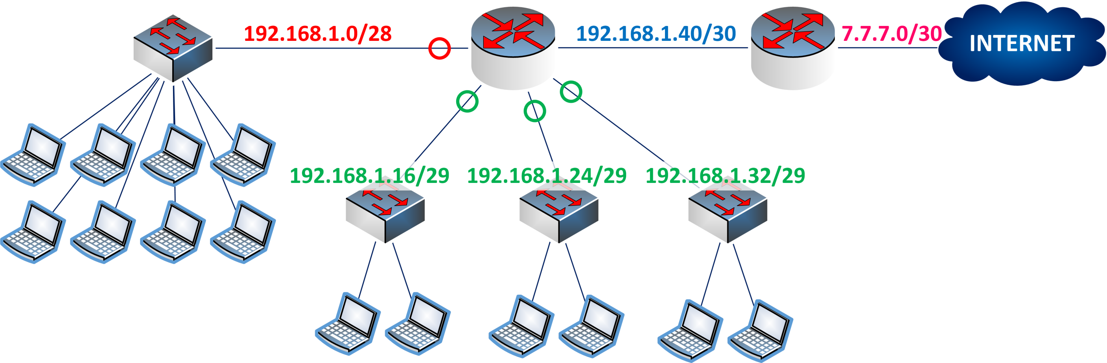
An Example

Slide 8
An Example

Slide 9
An Example
192.168.1.0/24

Slide 10
An Example
192.168.1.0/

Slide 11
An Example
192
192.168.1.0/

Slide 12
An Example
192.
192.168.1.0/

Slide 13
An Example
192.168
192.168.1.0/

Slide 14
An Example
192.168.
192.168.1.0/

Slide 15
An Example
192.168.1
192.168.1.0/

Slide 16
An Example
192.168.1.
192.168.1.0/

Slide 17
An Example
192.168.1. 00000000
192.168.1.0/

Slide 18
An Example
192.168.1. 00000000
192.168.1.0/

Slide 19
An Example
192.168.1. 00101011
192.168.1.0/

Slide 20
An Example
192.168.1. 00101011
43
192.168.1.0/

Slide 21
An Example
192.168.1. 00101011
43
192.168.1.0/

Slide 22
An Example
192.168.1. 00101011
43
192.168.1.0/

Slide 23
An Example
192.168.1. 00101011
43
192.168.1.0/26

Slide 24
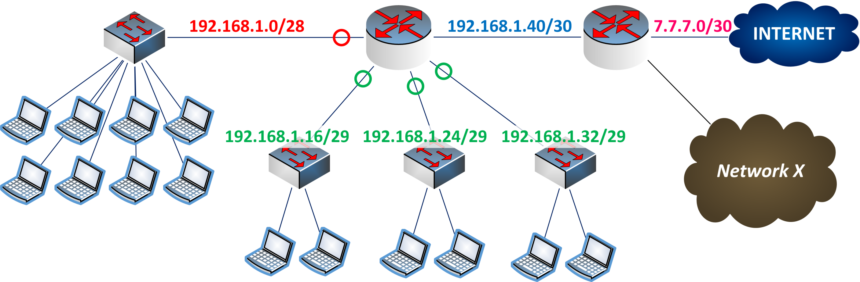
An Example
192.168.1. 00101011
43
192.168.1.0/26

Slide 25
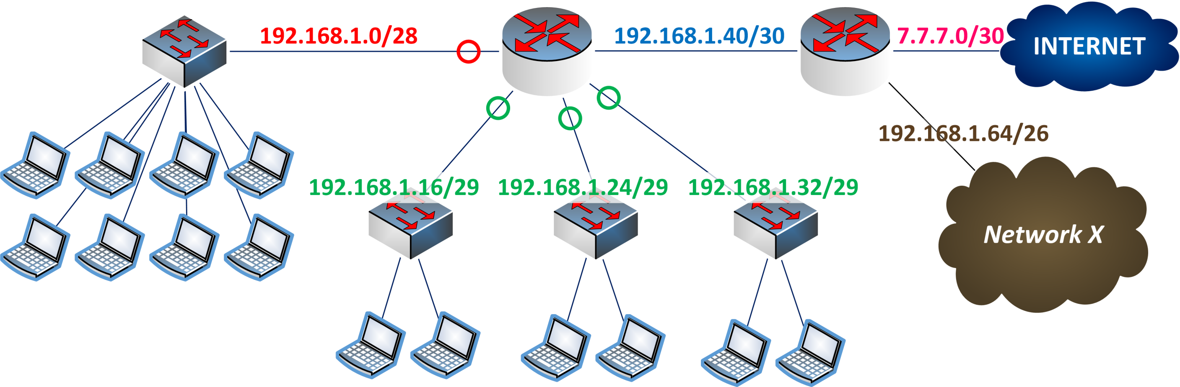
An Example
192.168.1. 00101011
43
192.168.1.0/26

Slide 26
An Example
192.168.1. 00101011
43
192.168.1.0/26

Slide 27
An Example
192.168.1. 00101011
43
192.168.1.1 – 192.168.1.63
192.168.1.0/26

Slide 28
An Example
192.168.1. 00101011
43
192.168.1.1 – 192.168.1.63
192.168.1.0/26

Slide 29
An Example
192.168.1. 00101011
43
192.168.1.1 – 192.168.1.63
192.168.1.0/26
192.168.1.65 – 192.168.1.127

Slide 30
IP Subnetting – Zero to Hero IP Summarization
CyberQuince

